Slide 1
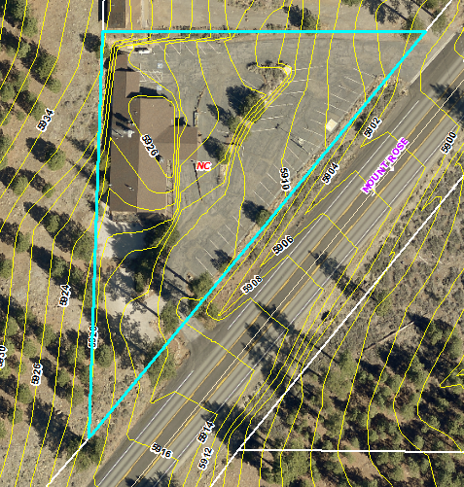
Amendment of Conditions WAC19-0003
Washoe County
Board of Adjustment
June 6, 2019
Lodge at Galena
Original Permit:
WADMIN18-0009

Slide 2
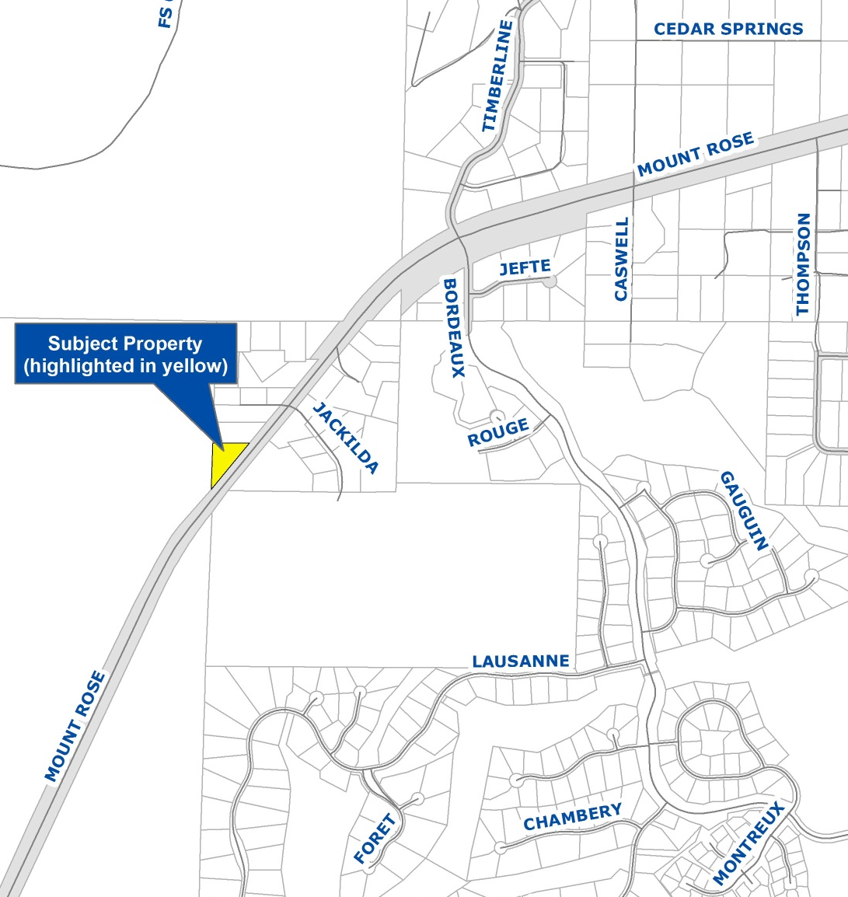
Vicinity Map
17025 Mt. Rose Highway
½ mile southwest of Timberline Drive
Previously the Lodge at Galena
Neighborhood Commercial
.99-acres
Within Mt. Rose Scenic Highway Commercial Overlay District

Slide 3
Overview of Request
Previous Admin. Permit issued August 2018:
  Snowind Sports
  Retail Sales – Specialty Stores use type
  Lodge Coffee + Wine
  Liquor Sales – On-Premises use type
Amendment seeks to extend operating hours for Lodge Coffee + Wine
Previous request for outdoor live music retracted; indoor music still provided
  Indoor music is expected part of original permit and does not require change to conditions

Slide 4
Overview of Request
Original permit
    Monday - Friday, 7 am - 7 pm
    Saturday/Sunday, 7 am - 8 pm
Current request: extend closing hours for wine and coffee bar
  June thru October
    Sunday - Thursday, 8 pm
    Friday/Saturday, 9 pm
  November thru May
    Sunday - Thursday, continue to close at 7 pm
    Friday/Saturday, 8 pm

Slide 5
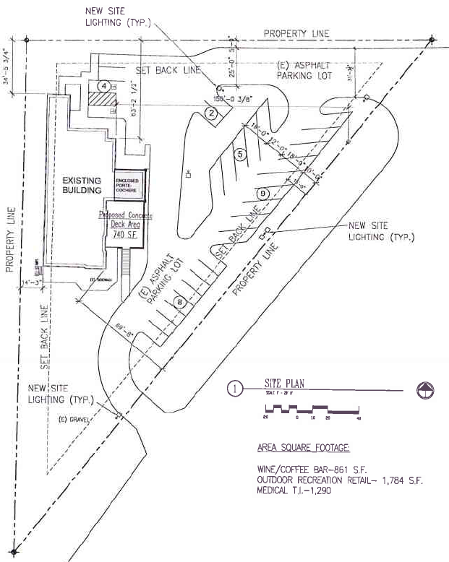
Site Plan
MT. ROSE HWY
MT. ROSE HIGHWAY

Slide 6
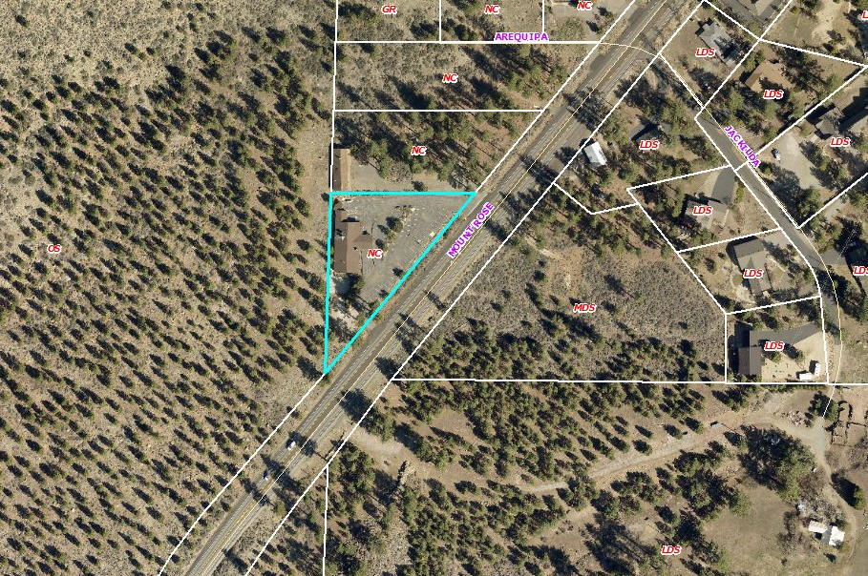
Aerial Photo

Slide 7
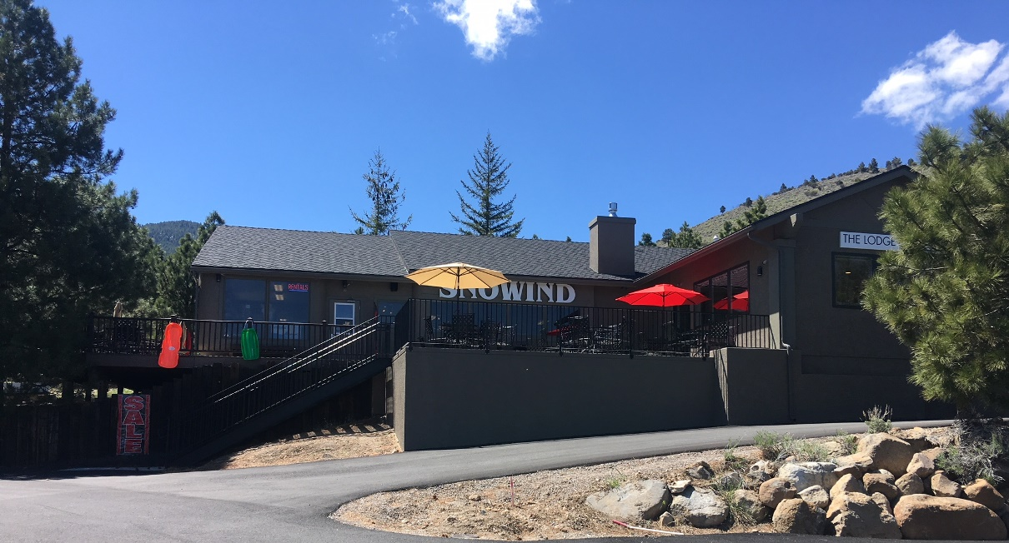
Site Photo

Slide 8
Citizen Advisory Board (CAB)
South Truckee Meadows/Washoe Valley CAB
  April 4: considered outdoor live music and forwarded comments
  May 30: no quorum; considered change to hours; suggested parking lot lighting turned off 1 hour after closing

Slide 9
Additional Condition per CAB
1(k)(ix)
  Parking lot lighting shall conform to the standards of the Development Code. Additionally, it shall be controlled with a timer and turned off within one hour of closing. Security lighting that is mounted to the building using cut-off, down-shielded fixtures is not subject to the time limitation.

Slide 10
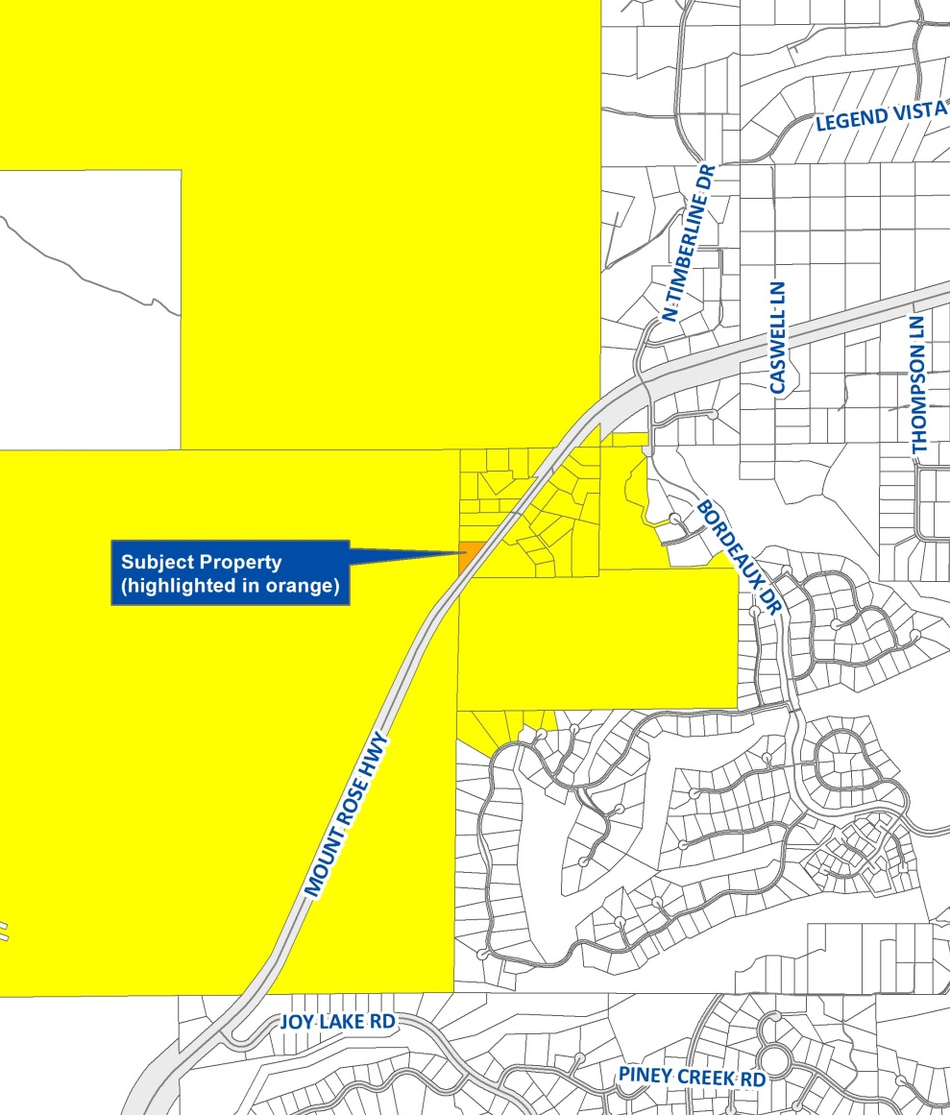
Public Notice
Notice provided to CAB and over 30 owners of 44 parcels within 1,500-ft.

Slide 11
Required Findings
Consistency
Improvements
Site Suitability
Issuance not Detrimental
F.2.13 Forest Area Plan community character
Recommendation: Approval with conditions with change from today

Slide 12
Possible Motion
I move that, after giving reasoned consideration to the information contained in the staff report and information received during the public hearing, the Washoe County Board of Adjustment approve Administrative Permit/Amendment of Conditions Case Number WAC19-0003 for Administrative Permit WADMIN18-0009, for Burkhart Management Group, with the amended conditions as included in Exhibit A, having made the four findings in accordance with Washoe County Code Section 110.808.25, and the additional finding F.2.13 as required by the Forest Area Plan.
This approval includes the addition of condition 1(k)(ix) as provided with the presentation.

